Slide 1
Balance Sheet
November 3, 2022
Wenchen Wang

Slide 2
First Half Semester
Introduction: Financial Management (Ch.1)
Planning:
Budgeting (Ch. 2; Ch. 5)
Costs (Ch. 4)
Financing (Ch. 6)
Implementing and Control
Short-term Resources and Obligations (Ch. 7)
Accountability and Control (Ch. 8)

Slide 3
Second Half Semester
Reporting Results:
Balance Sheet (Ch.9)
Activity and Cash Flow Statements (Ch. 10)
Unique Aspects of Accounting (Ch. 11-13)
Financial Analysis:
Financial Statement Analysis (Ch. 14)
Financial Condition Analysis (Ch. 15)

Slide 4
Financial Management
Financial Management
Managerial accounting
The generation of financial information for planning and decision making
Create financial plans
Implementation
Work towards achieving those plans
Financial accounting
A system for tracking and reporting the resources owned and used by an organization
Summarize data
Specific point in time
Reports to interested stakeholders
Notes:
Any information generated is primarily for the use of managers in their efforts to optimize the results of the organization (internal).
Preparation of financial reports that will be examined by individuals external to the organization is referred to as financial accounting.Banks, donors, landlords, vendors, legislators, regulators, unions, bond raters, and others are interested in the performance of public service organizations.
Managerial accounting is primarily prospective in nature. It is the process of preparing plans and then implementing and controlling activities to achieve desired results in the coming time periods. By contrast, financial accounting is historical. At the end of an accounting period, it looks back to see just how stable the organization is and how well it has actually done.

Slide 5
Financial Statements
Financial Statements
Statement of Financial Position (Balance Sheet)
A snapshot of the resources, obligations, and worth of an organization at a specific point in time (stock).
Activity Statement (Operating or Income Statement)
Measures the cumulative resource inflows and outflows for an organization over some specified period of time.
It is reporting equivalent of an operating budget (flow).
Cash Flow Statement
Measures the cumulative cash inflows and outflows for an organization over some specified period of time.
It is the reporting equivalent of a cash budget (flow).

Slide 6
Financial Statements
Statement of Financial Position
Balance sheet reports:
- what an organization owns (Assets),
- what it owes to outsiders (Liabilities), and
- the portion of the organization's assets owned by its owners. Called
Owner's Equity, Partners' Equity, Net Worth, or
Stockholders’ Equity (for-profit organizations).
Net Assets or Fund Balance (not-for-profit and governments).
at a specific point in time. For example, at the end of the organization's Fiscal Year.

Slide 7
Fundamental Equation of Accounting
Fundamental Equation of Accounting
Assets = Liabilities + Equity
Resources - Anything the organization owns of value
Portion of assets funded by own resources
For profit:– Stockholders Equity
Assets owned by owners
Non-profit and public: Net Assets / Net Position / Fund Balance
Outstanding debt
Obligations owed to outsiders

Slide 8
Fundamental Equation of Accounting
Assets - Liabilities = Equity
What you own
What you owe
What you are worth
Owner's Equity, Partners' Equity, Net Worth, or
Stockholders’ Equity (for-profit organizations).
Net Assets or Fund Balance (not-for-profit and governments).
Equation must always be in balance!
Notes:
Therefore, once we determine the organization’s assets and liabilities, the owners’ equity is a residual amount needed to balance the equation.
For-profit organizations have owners, and owners are responsible for the debt for the organization. This term highlights the fact that not-for-profit organizations and governments do not have owners who have a claim on the organization's wealth in the same way that for-profit organizations do. We can think of the organization itself or society as the “owner” of the net assets or net position of such organizations. Organizations sometimes subdivide their assets into distinct funds, each used for a different purpose. When considering just one of these funds, not-for-profit organizations and governments sometimes refer to this amount as the fund balance.
This is similar to the equity a person has in his or her house. If you buy a house for $500,000 and pay for it with $100,000 of your own money and $400,000 borrowed from a bank, the asset (the house) is worth $500,000, the liability you owe the bank (mortgage payable) is $400,000, and your equity in the house is $100,000.
double-entry accounting
If the equation is not in balance after a transaction is recorded, then an error must have occurred in the recording process.

Slide 9
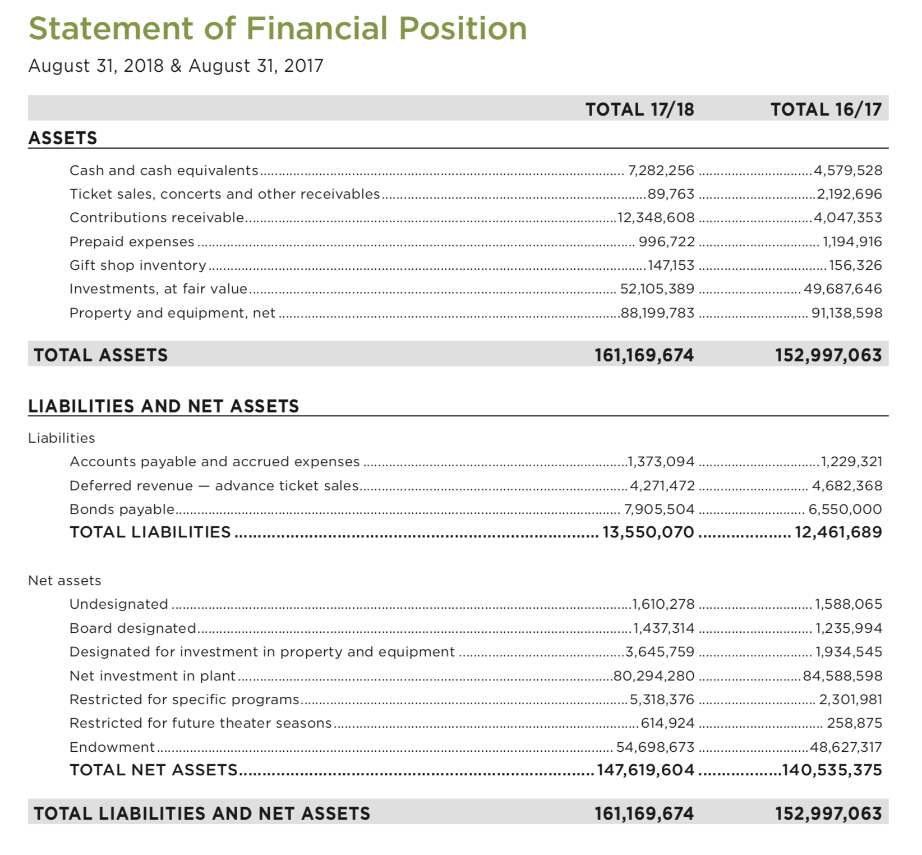
Financial position of the organization
Picture of the organization in a specific point of time
Fiscal Year - FY
Main Components
Fundamental Equation of Accounting
Accrual Basis of Accounting
Notes:
The balance sheet provides an overview of the financial position of the organization. How much cash does the organization have? What other resources does it own? Does it owe a lot of money to other organizations? Will that money have to be repaid in the near future? Knowing these information can help us inform the organizations for certain questions: Can the organization begin a rapid new expansion of services? Must it severely restrict its services to survive?

Slide 10
Financial Statements
Financial Statement Concept
Generally Accepted Accounting Principles from the FASB (not-for-profits and health care) or the GASB (governments) guide the preparation of financial statements.
Entity Concept requires that you define the organizational component for which you are trying to account.
Money Denominator Convention requires that all items included
on the financial statements be measurable in dollar terms.
Objective Evidence (objectivity or reliability principle) and the Cost Convention (cost principle) require that values be based on an objective valuation of resources. When there is a dispute over value, cost is used.
Notes:
Principles: Different reasonable people might disagree over what approach is best. CPAs take extensive coursework in accounting and finance, take a rigorous state licensing examination, and in most states must also have experience in the field before they can receive their CPA license and designation.
The entity concept requires us to define the person, organization, or part of an organization for which we intend to report financial results. All financial measurements must then use the perspective of that entity. Eg: whether it is the executive director or the entire organization.
Once we have identified the entity of interest, we can prepare a budget for the entity, track money the entity receives or spends, and prepare reports showing how well the entity has done from a financial perspective.
The benefit of the monetary denominator is that it allows us to summarize information. However, determining the appropriate value to report is not always easy.
It is important for users of financial statements to understand that assets on balance sheets are not necessarily shown at their current fair value. Inventories and Fixed assets are normally using cost convention.
One exception to the cost convention relates to investments in marketable securities. Marketable securities are stocks and bonds that can readily be sold in stock or bond markets. Many online and in-print news sources report the closing price of such securities at the end of each business day. This provides a source of objective evidence. Given the ability to assign a current fair value to these securities based on objective evidence, they generally do not follow the cost convention.

Slide 11
Financial Statements
Financial Statement Concept
Conservatism says that you should anticipate losses but not gains.
Going Concern Concept assumes that the organization will continue in operation. Bankruptcy values may be lower.
Materiality says that reporting only needs to contain the level of detail and accuracy necessary for decision-making. Financial reports do not need to be exactly accurate.
Accrual Concept states that revenues are recorded when the organization has earned them and expenses are recorded when resources are used to generate revenues.
Notes:
One example of conservatism relates to how investments are shown on the balance sheet. For a long time, one impact of the conservatism principle was that if the organization owned shares of stock, it would report the stock investment on its balance sheet at the lower of its cost or market value. If the stock went down in value, perhaps from a $100 purchase price to a $50 fair value, we would report it at its lowered value. However, if it went up in value, perhaps from a $100 purchase price to a $200 fair value, we would just report it at its $100 cost.
If the errors are too small to affect the decisions of any users of the financial statement, they are not material. For example, $150,238,917 vs $150,238,197

Slide 12
Assets
Assets
What the organizations owns. Listed in order of declining liquidity
Current Assets
Those that are cash or cash-equivalents or are expected to become cash or will be used up within twelve months
Include:
Cash and cash equivalents
Marketable securities
Accounts receivable
Inventory – recorded at cost
Prepaid expenses
Long-Term Assets
Used in more than a year
Include:
Fixed Assets
Property (land) - recorded at cost
Plant (buildings) - recorded at cost and reported at net book value
Equipment - recorded at cost and reported at net book value
Investments
Deferred charges: Long-term prepaid expenses
Intangibles: Patents, good will
Notes:
We can define an asset as being anything of value the entity owns. Another view is that assets are anything the organization owns as a result of past transactions and events that will better enable it to meet its mission
Marketable securities
Equity security (stock) and nonequity security (debt) that the organization can buy/sell in financial mark. Marketable securities are liquid because they can be bought and sold on any business day with settlement of the sale made in cash within a few days
Receivables
Bills that have been sent out by the organization but have not yet been collected
Some assets do not have a physical form or substance. If a taxpayer in Millbridge owes the town real estate taxes, the amount owed to the town is classified as an asset, referred to as a receivable. The general group of assets called receivables refers to amounts of money that other people or organizations owe to the entity, generally because of goods or services that the entity has provided to them. HOS has patient receivables. Because the entity must keep track of or keep account of how much money each patient owes, we often refer to the amounts owed in this manner as accounts receivable.
The accounts receivable aging report, discussed in Chapter 7, is particularly valuable for helping managers make an estimate of the amount of receivables that will never be collected.
Prepaid expenses are assets that represent prepayments. For example, suppose that we paid $100 for a 1-year fire insurance policy on the last day of the year. The cash is gone, but the fire insurance will protect us all next year.
Intangible asset: They are only recorded if they are acquired through a specific exchange transaction. For example, if during a merger, the amount one hospital pays to acquire another hospital exceeds the value of the assets. This would include various intangibles such as a good reputation, the ability to provide quality services, the skills of the entity’s employees, and so on. These intangibles are grouped together and called goodwill.

Slide 13
Accounts Receivable, Net
Account Receivables, Net
Risk: Not all accounts receivable are going to be collected
Conservatism: Organizations should anticipate losses but not gains
→ Provision or Allowance for uncollectable amounts
An organization has $45,000 in accounts receivable. Its client is having financial troubles and is not meeting the payments. The organization decides to create a provision of 8% of the receivable.
Account Receivable $45,000
Provision $(3,600)
Account Receivable, Net $41,400
Notes:
Conservatism dictates that it is necessary to estimate the portion of the receivables that will not be collected. This estimated uncollectible portion is subtracted from the total accounts receivable, and the resulting amount, referred to as “accounts receivable, net” is reported as an asset on the balance sheet.

Slide 14
Inventories
Registered at a cost
Jan. 3: bought 1,000 units at $5 a piece
Jan. 10: bought 2,000 units at $4 a piece
Jan. 15: bought 1,000 units at $3 a piece
Notes:
Cost convention: In particular, inventory and land are shown at their cost

Slide 15
Fixed Assets
Fixed Assets
Recorded at cost when acquired.
Reported net of accumulated depreciation on the balance sheet.
Suppose an organization buys a van for $45,000 and expects to use it for five years and sell it for $5,000. Assuming that the van will be used up evenly over the five years, how would its value appear on the balance sheet at the end of two years?
Notes:
Cost convention: Buildings and equipment are shown at their cost reduced by an allowance for accumulated depreciation. Depreciation represents the portion of capital assets charged as expenses as the assets are used over time.

Slide 16
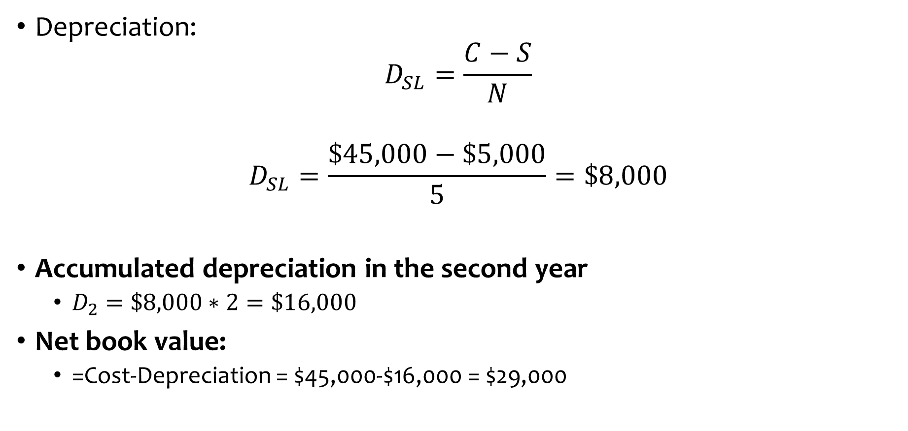
Example
Fixed Assets: Example
Depreciation:
$$D_{SL}=\frac{C−S}{N}$$
$$D_{SL}=\frac{\$45,000−\$5,000}{5}=\$8,000$$
Accumulated depreciation in the second year
$D_{2}=\$8,000∗2=\$16,000$
Net book value:
=Cost-Depreciation = $45,000-$16,000 = $29,000

Slide 17
Fixed Assets on the Balance Sheet
Museum A
Museum B
Net Fixed Assets or Net Book Value | $ 1,000,000 | $ 1,000,000
Are these two museums similar or different?
PP&E at cost | $ 40,000,000 | $ 2,000,000
Accumulated Depreciation | (39,000,000) | (1,000,000)
Net Book Value | $ 1,000,000 | $ 1,000,000
The three values (cost, depreciation, and net book value) help us to:
Understand the size of an organization
How old the facilities are
Notes:
Shown in the balance sheet.
If not, they are in the notes

Slide 18
Liabilities
Liabilities
What the organization owes. Listed depending on when are due for payment.
Current Liabilities
Short-term liabilities
To be paid in one year
Includes:
Payables
Wages or salary payable
Taxes payable
Accounts payable (due within 30 days)
Portion of long-term debt which is due during the coming year
Long-Term Liabilities
To be paid in more than one year
Recorded at the present value of the required future payments
Include:
Long-term debt
Capital leases
Long-Term Notes Payable
Mortgages
Bonds Payable
Pension Liabilities
Contingent Liabilities
Notes:
Payable: amounts owed.
Long-term notes refer to when the organization borrows money and signs a note promising repayment. The note indicates the specific terms under which the money has been borrowed, such as the interest rate and timing of payments. Long-term notes are often unsecured loans.
Mortgages are loans secured by a specific asset. The asset is generally real estate. That is, land and buildings are used as collateral for the loan. Often, the funds are being borrowed to purchase the collateral.
Bonds is the standardized payment agreements between the lenders and the borrowers. When organizations borrow large amounts of money, they often issue (i.e., sell) a bond. Each individual investor in a bond lends a portion of the total amount to the organization in exchange for the organization’s promise to repay the loan. That promise is evidenced by a formal document called a bond.
A pension liability is the difference between the total amount due to retirees and the actual amount of money the company has on hand to make those payments.
A contingent liability is a potential liability that may occur in the future, such as pending lawsuits or honoring product warranties. If the liability is likely to occur and the amount can be reasonably estimated, the liability should be recorded in the accounting records of a firm.

Slide 19
Amortizing Long-Term Debt
Suppose an organization takes out a 5-year, $100,000 mortgage at an annual interest rate of 8%. The mortgage calls for annual of $25,045.65.
What amounts would be shown under current and long-term liabilities on the balance sheet at the end of Year 2?
 | Beginning | Total | Interest | Principal | Ending Principal
 | Balance | Payment | Portion | Portion | Balance
Year 1 | 100,000.00 | 25,045.65 | 8,000.00 | 17,045.65 | 82,954.35
Year 2 | 82,954.35 | 25,045.65 | 6,636.35 | 18,409.30 | 64,545.05
Year 3 | 64,545.05 | 25,045.65 | 5,163.60 | 19,882.05 | 44,663.00
Year 4 | 44,663.00 | 25,045.65 | 3,573.05 | 21,472.60 | 23,190.40
Year 5 | 23,190.40 | 25,045.65 | 1,855.25 | 23,190.40 | 0

Slide 20
Asset & Liability Recognition
Asset & Liability Recognition
Assets are recognized if:
It is owned by the organization
It has a monetary value
The monetary value can be objectively measured
Liabilities are recognized when:
They are legally owed
Have to be paid
The amount to be paid can be objectively measured

Slide 21
Net Assets
Net Assets
Donations and surpluses retained by the organization.
Donations: Restricted by donors
Without Donor Restrictions
Unrestricted donations
Board-designated funds
With Restrictions
Time
OR
Purpose
Temporary Restricted
Permanently Restricted
Which are restricted in perpetuity.

Slide 22
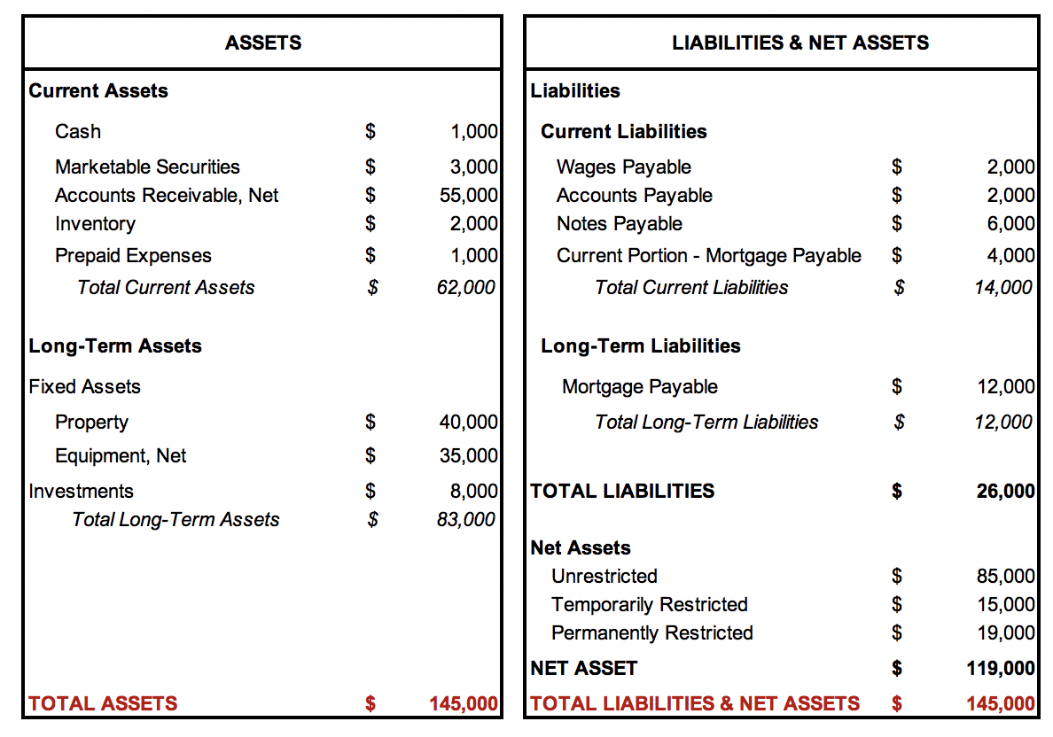
Meals for the Homeless Statement of Financial Position

Slide 23
Recording Transactions
Recording Transactions
CONCEPTS
A journal is a chronological listing of every financial event that occurs in an organization.
Every type of asset, liability, revenue, or expense is referred to as an account. Organizations may have as many accounts as they need.
STEPS
Determining what has happened
Identify what accounts will be impacted
Record the transaction
Verify that the equation is balanced - Double-entry accounting
Notes:
The goal of financial accounting is to report financial information that is useful to external users. To prepare such reports, a system is needed to record financial events as they occur.
The term double-entry does not mean that the transaction is recorded twice. It means that both parts of the transaction are recorded, allowing the fundamental equation to remain in balance. At least two items to change.

Slide 24
Recording Transactions
Recording Transactions
Example: Organization buys books for $200
Assets = |  | Liability + | Net Assets
Cash
Inventory
$200
No change
No change
The equation is not balanced!
Notes:
The left side of the equation has increased by $200, but the right side is unchanged. The equation is no longer balanced because $200 does not equal $0. To describe an entire event, it is necessary to record a change to at least two elements in the fundamental equation.

Slide 25
Recording Transactions
Recording Transactions
Example: Organization buys books for $200, pays 3 months later
Assets = |  | Liability + | Net Assets
 |  | Accounts Payable
Cash
Inventory
$200
$200
No change
The equation is balanced!
Notes:
. In this example, the hospital has purchased a piece of equipment. Assume that HOS has not yet paid for the equipment but expects to pay within 30 days. The organization’s liabilities have charged.

Slide 26
Recording Transactions
Recording Transactions
Example: Organization buys books for $200, pays cash
Assets = |  | Liability + | Net Assets
 |  | Accounts Payable
-$200
Cash
Inventory
$200
No Change
No change
The equation is balanced!
Notes:
One sided change example

Slide 27
Recording Transactions
Recording Transactions
Example: Organization buys books for $200, pays $100 cash
Assets = |  | Liability + | Net Assets
 |  | Accounts Payable
-$100
Cash
Inventory
$200
$100
No change
The equation is balanced!

Slide 28
Recording Transactions
Recording Transactions - Example
Example: A bookstore buys 100 books for $1,000 in total and pays for them in cash.
1. What has happened?
Bought 100 books for $1,000.
Paid the books in cash.
2. What accounts will be impacted?
Cash: Asset
Inventory: Asset
3. Record:
Assets = |  | Liability + | Net Assets
Cash
Inventory
($1,000)
$1,000
No change
No change
The equation is balanced!

Slide 29
Assets - Example
Assets - Example
A theater buys coffee, cups, and cookies for the restaurant at a value of $1,000. The supplier will send half of the supplies today and half of the supplies the next year. The theater pays everything in cash.
What has happened? -- What accounts will be impacted?
Inventory: Asset
Inventory receivable/Inventory in transit: Asset
Cash: Asset
Assets |  |  | = | Liabilities + | Net Assets
 |  |  | =
 |  |  | =
Cash
Inventory
Inventory in transit
($1,000)
$500
$500
No change
No change
The equation is balanced!

Slide 30
Liabilities - Example
Liabilities - Example
A theater borrows $10,000 from the bank, payable in 5 years, to pay a debt with one of the suppliers. In the first year, the theater must pay one-fifth of the debt.
What has happened? -- What accounts will be impacted?
Accounts payable: Liability
Short-term debt: Liability
Long-term debt: Liability
Assets | = | Liabilities |  |  | Net Assets
Accounts Payable
Short-Term Debt
Long-Term Debt
No change
($10,000)
$2,000
$8,000
No change
The equation is balanced!

Slide 31
Asset/Liability Example
Asset/Liability - Example
A theater buys coffee, cups, and cookies for the restaurant at a value of $1,000 and will pay for it in three months.
What has happened? -- What accounts will be impacted?
Inventory: Assets
Account payable: Liability
Assets | = | Liabilities | Net Assets
 | =
 | =
Inventory
Accounts payable
$1,000
$1,000
No Change
The equation is balanced!

Slide 32
Asset/Liability Example
Asset/Liability - Example
HOS mails a check to its bedpan supplier for $2,000 to pay part
of the $7,000 it owed them at the start of the year.
What has happened? -- What accounts will be impacted?
Cash: Asset
Account payable: Liability
Assets | = | Liabilities | Net Assets
 | =
 | =
Inventory
Accounts payable
$-2,000
$-2,000
No Change
The equation is balanced!

Slide 33
Asset/Liability Example
Collection- Example
HOS receives $12,000 from customers. This was owed to
HOS for care provided during the previous year.
What has happened? -- What accounts will be impacted?
Cash: Asset
Account receivables
Assets | = | Liabilities | Net Assets
 | =
 | =
Inventory
Accounts payable
$-2,000
$-2,000
No Change
The equation is balanced!

Slide 34
Net Asset - Example
Net Asset - Example
A musician is donating $5,000 to the theater in cash. This musician only requires that $2,000 are restricted for three years.
What has happened? -- What accounts will be impacted?
Unrestricted: Net Assets
Temporarily restricted: Net Assets
Cash: Assets
Assets | = | Liabilities | Net Assets
 | =
 | =
Cash
Unrestricted
Temp. Restricted
$5,000
No Change
$3,000
$2,000
The equation is balanced!

Slide 35
Net Asset - Example
Net Asset - Example
The equipment for an organization depreciates by $5000
What has happened? -- What accounts will be impacted?
Assets: Equipment
Net Assets
Assets | = | Liabilities | Net Assets
Equipment | =
-$5000 | = | No Change | -$5000
The equation is balanced!

Slide 36
Asset/Liability Example
A Non-Transaction
HOS signs a binding contract to buy an X-Ray machine that will
cost $50,000.
What has happened? -- What accounts will be impacted?
This event will not give rise to a journal entry because it does not
meet the rules for recognition.
- The value of the transaction is known.
- The timing of the transaction is known.
- But, HOS does not yet own the equipment. There has been
no exchange! So HOS does not owe the money! No liability
is recorded unless we owe the creditor.

Slide 37
Generating a Balance Sheet
Generating a Balance Sheet
Beginning with the starting balance sheet
Recording all the transactions for the period
Adding the impact of the transactions to the starting balance sheet
Formatting the resulting balance sheet accounts into the balance sheet reporting format

Slide 38
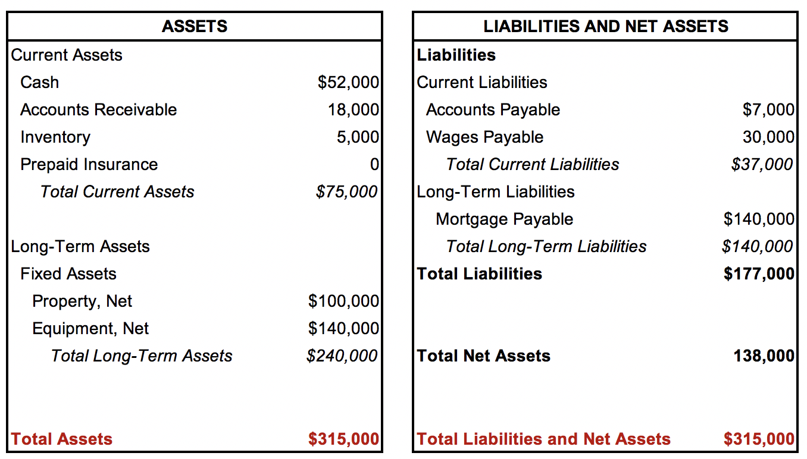
Starting Balance Sheet
Starting Balance Sheet

Slide 39
Transitions Work Sheet
Transactions Work Sheet
 | Assets = |  |  |  |  | Liabilities + |  |  | N.A.
Beginning Balance
Ending Balance
Cash
Accounts Receivable
Inventory
Prepaid Ins.
Plant & Equip
Accounts Payable
Wages Payable
Mortgage Payable
Net Assets
$52,000
$18,000
$5,000
$0
$240,000
$7,000
$30,000
$140,000
$138,000
Trans. 1
Trans. 2
Trans. 3
Trans. 4
Trans. 5

Slide 40
Transactions
Transactions
HOS purchased a fire insurance policy for $100. A check was mailed to pay for the policy.
HOS mails a check to its supplier for $2,000 of the $7,000 it owed at the end of the prior fiscal year.
HOS places an order with a medical supply company to buy a special-order X-ray machine. It will cost $50,000, and it will take more than a year to be delivered. HOS signs a contract to buy the machine.
HOS purchases inventory on account for $3,000. When this inventory is used to provide patient care, the hospital will be able to charge $6,000 for it. The inventory has been received, but HOS has not paid for it.
Payments are received from insurance companies for patient care provided last year. HOS receives $12,000 of cash.

Slide 41
Transitions Work Sheet
Transactions Work Sheet
 | Assets = |  |  |  |  | Liabilities + |  |  | N.A.
Beginning Balance
Ending Balance
Cash
Accounts Receivable
Inventory
Prepaid Ins.
Plant & Equip
Accounts Payable
Wages Payable
Mortgage Payable
Net Assets
$52,000
$18,000
$5,000
$0
$240,000
$7,000
$30,000
$140,000
$138,000
Trans. 1
($100)
$100
Trans. 2
($2,000)
($2,000)
Trans. 3
Trans. 4
$3,000
$3,000
Trans. 5
$12,000
($12,000)
$61,900
$6,000
$8,000
$100
$240,000
$8,000
$30,000
$140,000
$138,000

Slide 42
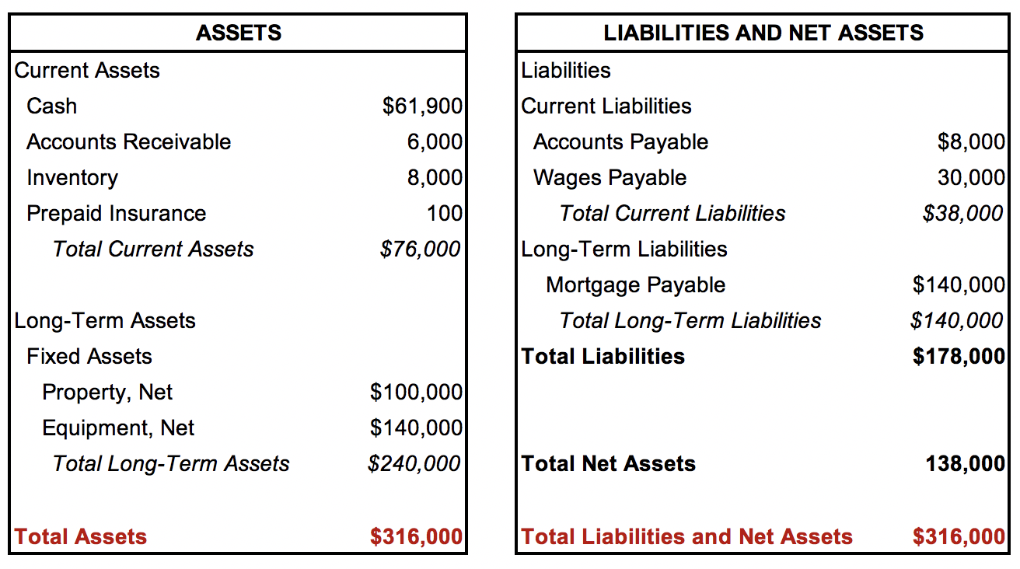
Ending Balance Sheet
Ending Balance Sheet

Slide 43
Credit and Debit
Credit and Debit
Bookkeeping
DEBIT
Increases asset
Decreases liability or equity
CREDIT
Decreases asset
Increases liability or equity

Slide 44
Credit and Debit Examples
Example
If an organization purchases inventory worth $2000 on account, the journal entry would appear as follows:
 | DR. | CR.
Inventory | $2,000
Accounts Payable |  | $2,000
Explanation: To record purchase of inventory.

Slide 45
Credit and Debit Examples
Example
 | Assets |  | Liabilities
Transaction | Debit | Credit | Debit | Credit
1. Receive a cash in payment of an account receivable
2. Purchase inventory from supplier on credit
3. Repay a loan

Slide 46
Credit and Debit Examples
Example
Receive a cash in payment of an account receivable
Cash increases → Debit in the cash account (A)
Account receivable decreases → Credit in the accounts receivable account (A)
Purchase inventory from supplier on credit
Inventory increases → Debit in the inventory account (A)
Accounts payable increases → Credit in the accounts payable account (L)
Repay a loan
Cash decreases → Credit in the cash account (A)
Loan payable decreases → Debit in the accounts payable account (L)

Slide 47
Credit and Debit Examples
Example
 | Assets |  | Liabilities
Transaction | Debit | Credit | Debit | Credit
1. Receive a cash in payment of an account receivable
2. Purchase inventory from supplier on credit
3. Repay a loan
$
$
$
$
$
$

